Slide 1



DevOps in the Cloud for the .NET Developer
Scott Addie | Senior Content Developer | @Scott_Addie

Slide 2
Agenda
Overview of DevOps
Right-click > Publish
Azure DevOps Services
Azure Pipelines
Docker
GitHub
Demo

Slide 3

What is DevOps?
Developers, Operations, QA
People
Products
Process
…the union of people, process, and products to enable continuous delivery of value to our end users. – Donovan Brown, Microsoft
Continuous Build & Delivery
DevOps
Azure DevOps Services
Notes:
People following a process enabled by products to deliver value to end users

Slide 4



The DevOps CI/CD pipeline
Git repo
Build tasks
Release tasks

Slide 5

The fallacy of right-click > Publish
Doesn’t scale beyond 1 person
Local dependencies may differ from prod
Steps are forgotten

Slide 6
Azure DevOps Services
Replaced VSTS on 9/10/18

Slide 7





Introducing Azure DevOps
Azure Boards
Azure Pipelines
Azure Repos
Deliver value to your users faster using proven agile tools to plan, track, and discuss work across your teams.
Build, test, and deploy with CI/CD that works with any language, platform, and cloud. Connect to GitHub or any other Git provider and deploy continuously.
Get unlimited, cloud-hosted private Git repos and collaborate to build better code with pull requests and advanced file management.
Azure Test Plans
Azure Artifacts
➔
Test and ship with confidence using manual and exploratory testing tools.
Create, host, and share packages with your team, and add artifacts to your CI/CD pipelines with a single click.
https://azure.com/devops
Notes:
So does TFS

Slide 8

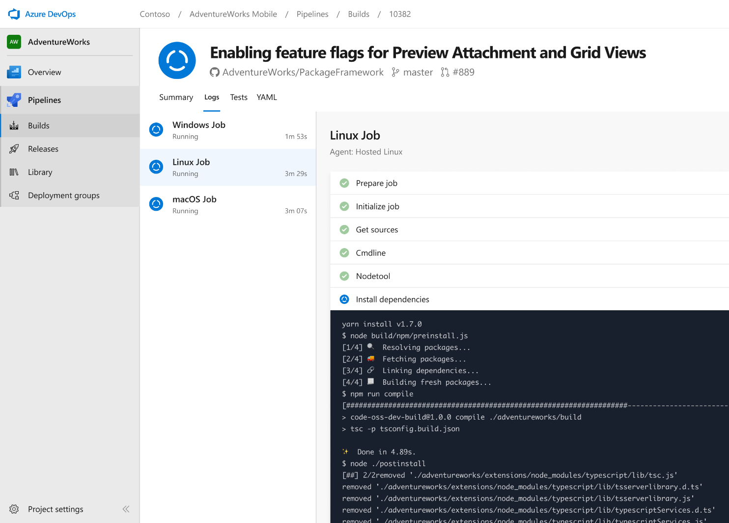




Azure Pipelines
Cloud-hosted pipelines for Linux, Windows and macOS, with unlimited minutes for open source
Any language, any platform, any cloud
Build, test, and deploy Node.js, Python, Java, PHP, Ruby, C/C++, .NET, Android, and iOS apps. Run in parallel on Linux, macOS, and Windows. Deploy to Azure, AWS, GCP or on-premises
Extensible
Explore and implement a wide range of community-built build, test, and deployment tasks, along with hundreds of extensions from Slack to SonarCloud. Support for YAML, reporting and more
Containers and Kubernetes
Easily build and push images to container registries like Docker Hub and Azure Container Registry. Deploy containers to individual hosts or Kubernetes.
Best-in-class for open source
Ensure fast continuous integration/continuous delivery (CI/CD) pipelines for every open source project. Get unlimited build minutes for all open source projects with up to 10 free parallel jobs across Linux, macOS and Windows
➔
https://azure.com/pipelines
Notes:
Azure Pipelines is the perfect launchpad for your code – automating your builds and deployments so you spend less time with the nuts and bolts and more time being creative

Slide 9


Azure Pipelines
Microsoft Open Source
Free unlimited build minutes for public projects
Up to 10 free parallel jobs across Windows, Linux, and macOS
➔
https://azure.com/pipelines
Notes:
All the builds you need, using the power of Azure you get one service that gives you unlimited build minutes where you can build on Windows Mac and Linux in parallel using a single build YAML file.

Slide 10

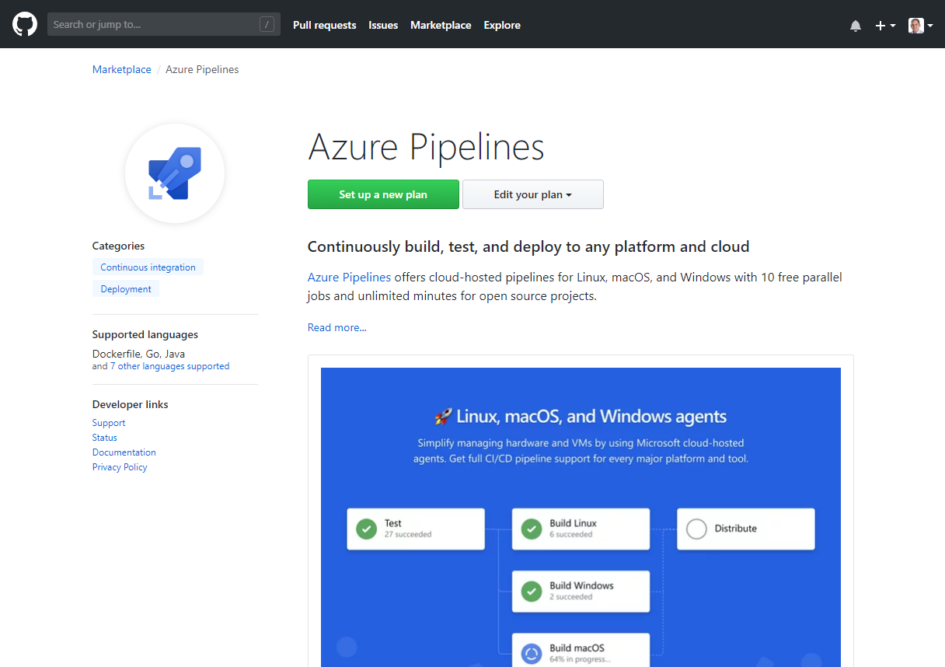
Integrated with GitHub
Azure Pipelines available now to any developer from the GitHub Marketplace

Slide 11
Build pipeline
No knowledge of environments
Build once, deploy anywhere
Run unit tests & publish outcome
Package up artifacts
Use UI or express config & steps in YAML

Slide 12
Hosted build agents
No maintenance or upgrades to think about
5 VM images w/ .NET Core SDK preinstalled:
Ubuntu 16.04
VS 2017 on Win Server 2016
macOS 10.13
Win Server 1803 (for running Windows containers)
VS 2015 on Win Server 2012R2
Notes:
https://docs.microsoft.com/azure/devops/pipelines/agents/hosted?view=vsts&tabs=yaml

Slide 13
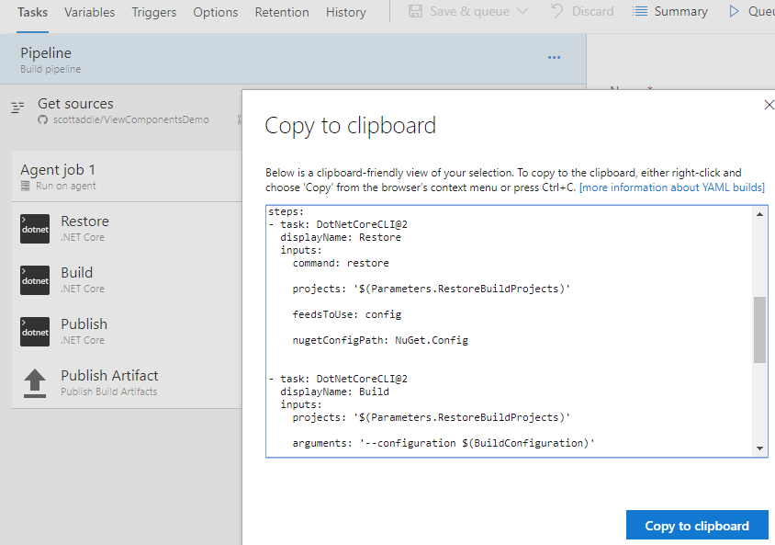
Build pipeline construction
Notes:
YAML is a 1st-class citizen

Slide 14
Unit testing
Coverlet for xplat

Slide 15
Release pipeline
Has knowledge of environments
Deploy artifacts produced by build
Run integration tests

Slide 16
Demo
Build & deploy an app

Slide 17
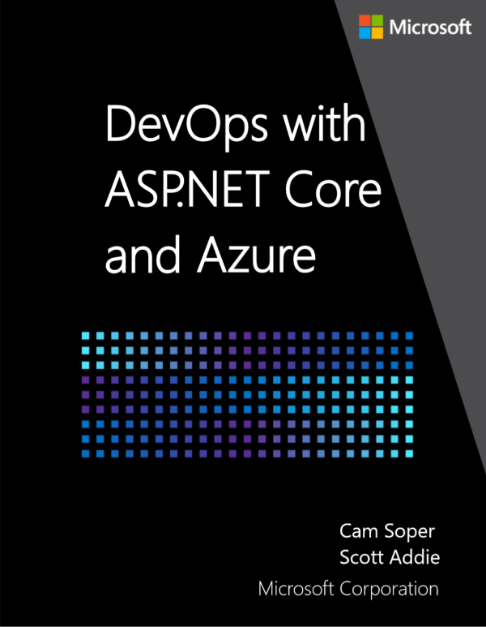

Resources
eBook aka.ms/aspnetdevops
Slides
aka.ms/aspnet-devops-slides
@Scott_Addie

